Slide 1
Time Machine
Buffer over Flow Team

Slide 2
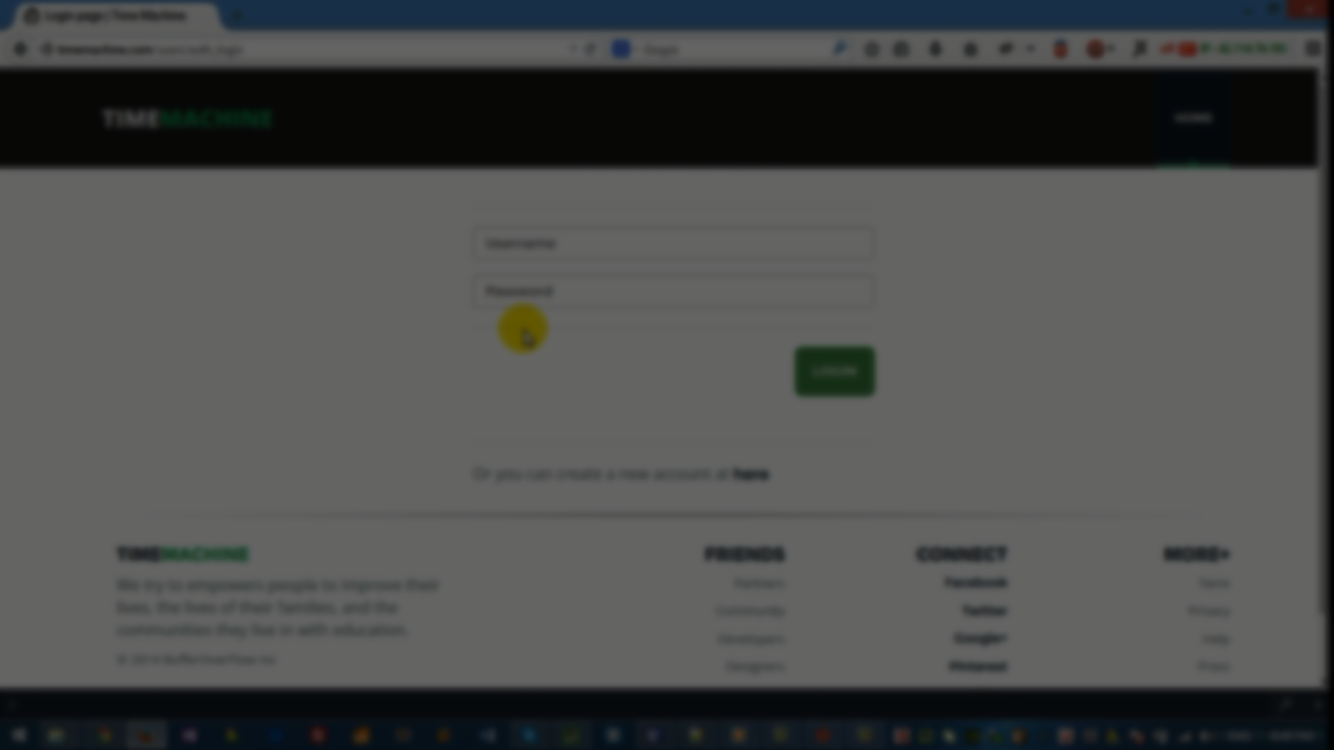
About the Project
Time Machine is a dynamic website implemented on Python Django,
at making it easier to keep track of students'aims learning schedule and gather courses' information and materials in one place.

Slide 3

Our goals:
1. Make it easy to create/enroll in courses.
2. Interactive Timetables
3. Inspiring Courses' pages
4. Tracking learners' progress

Slide 4
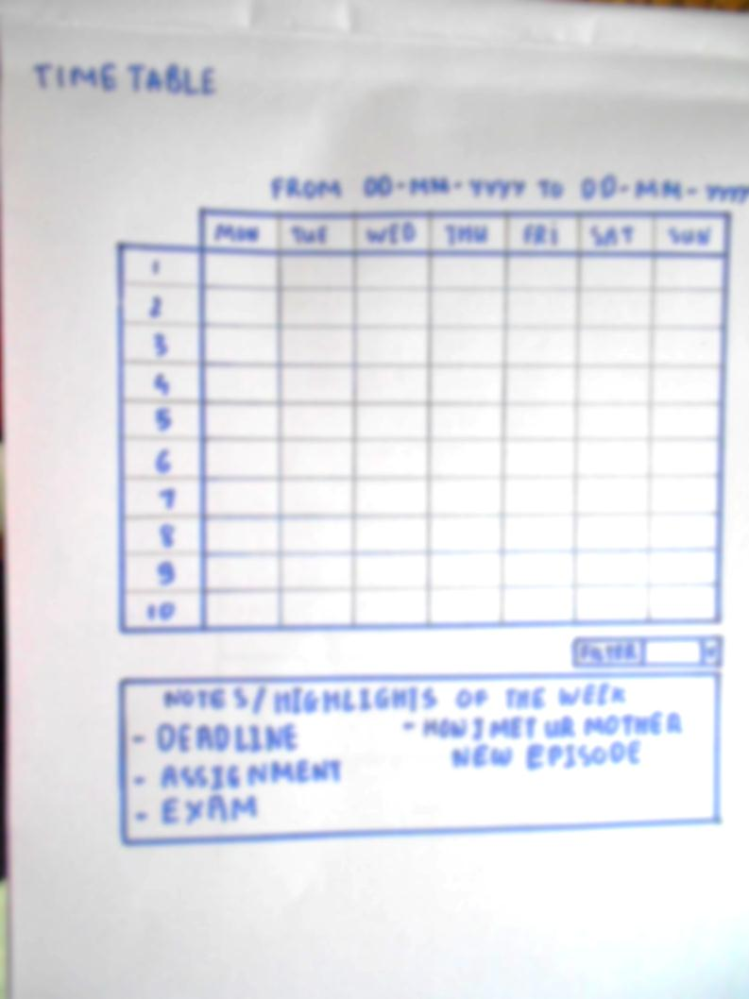
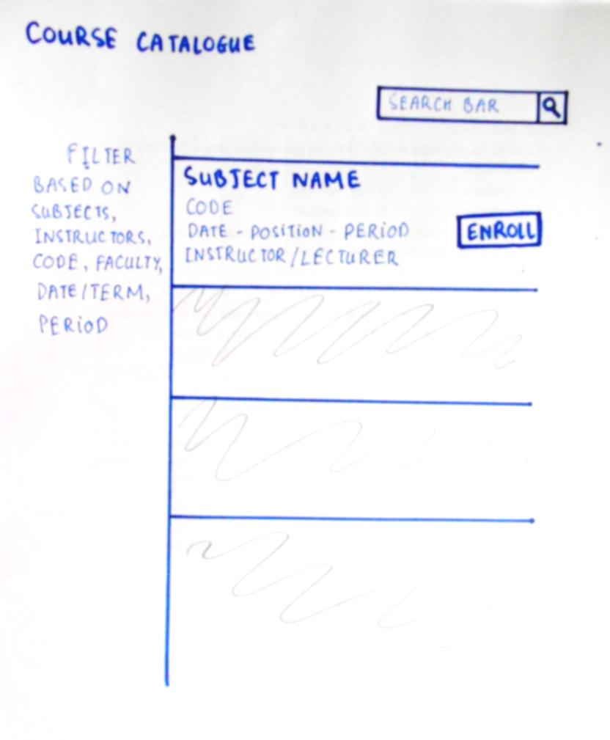
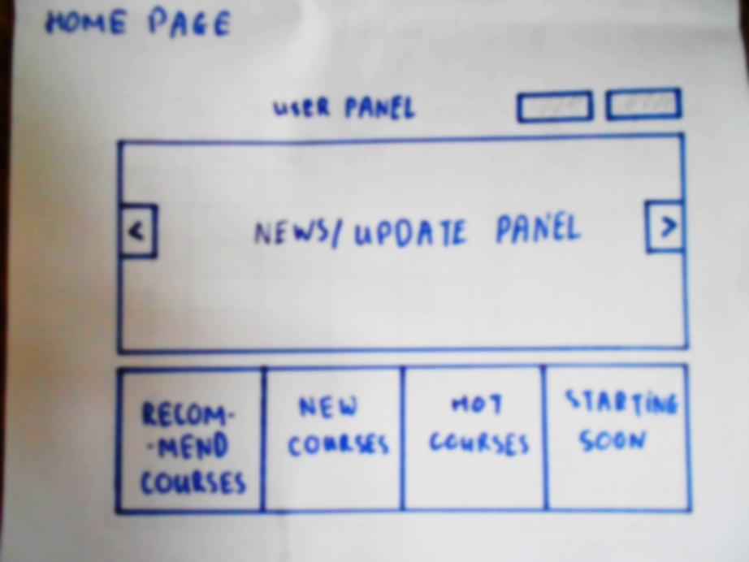
Paper Mockup
Prototyping

Slide 5
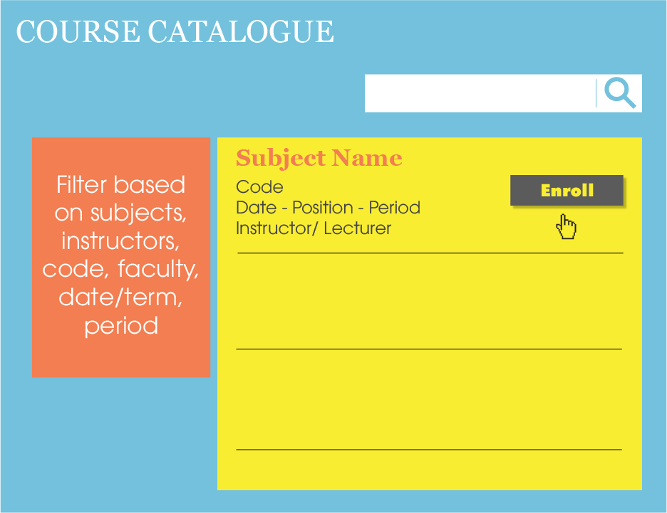

Slide 6
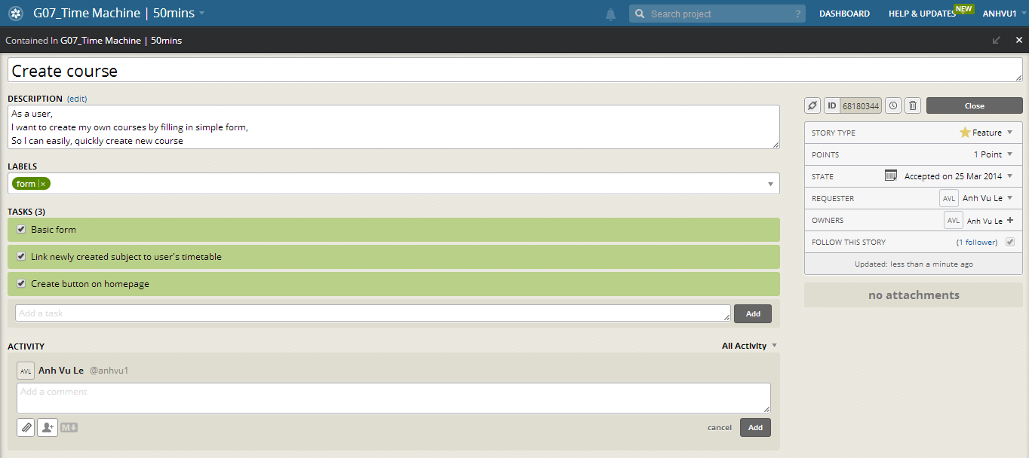
User Story #1

Slide 7
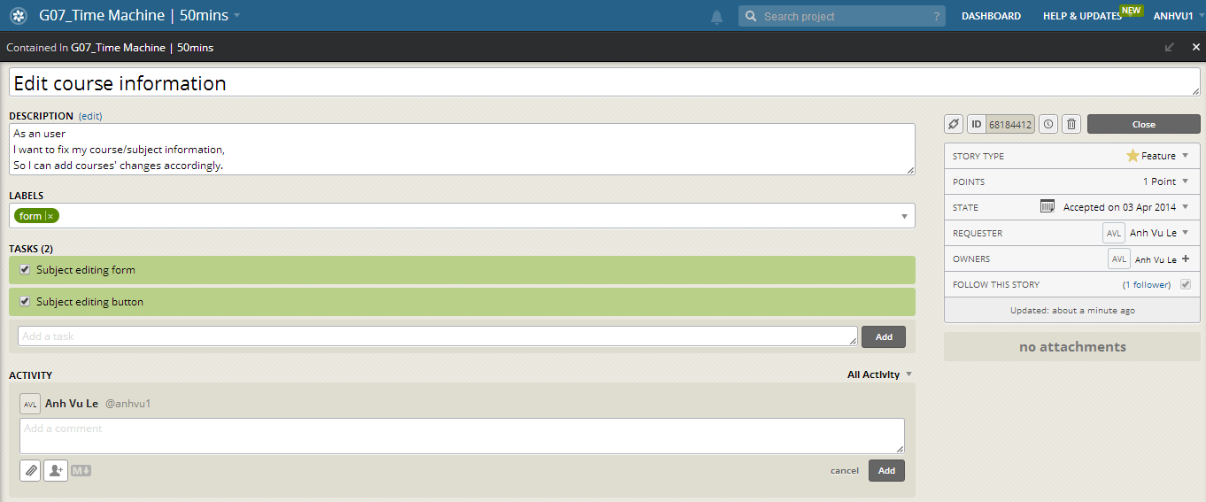
User Story #2

Slide 8
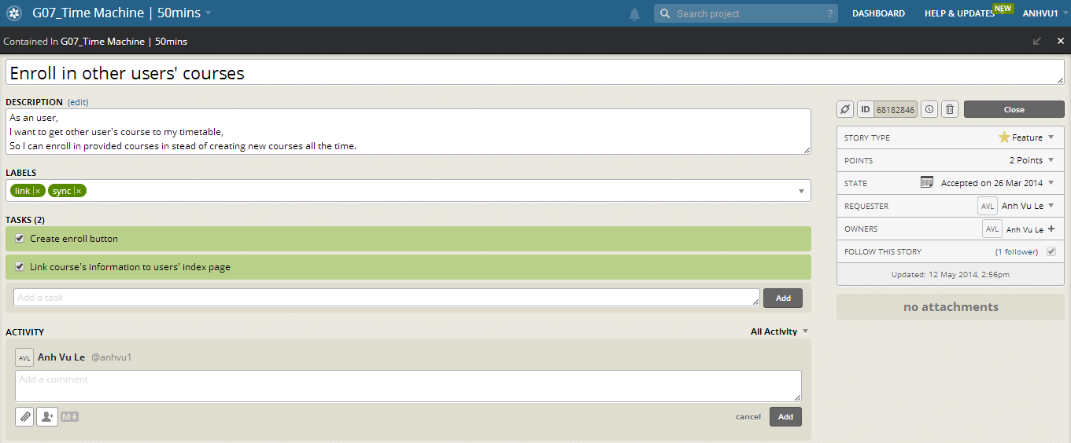
User Story #3

Slide 9
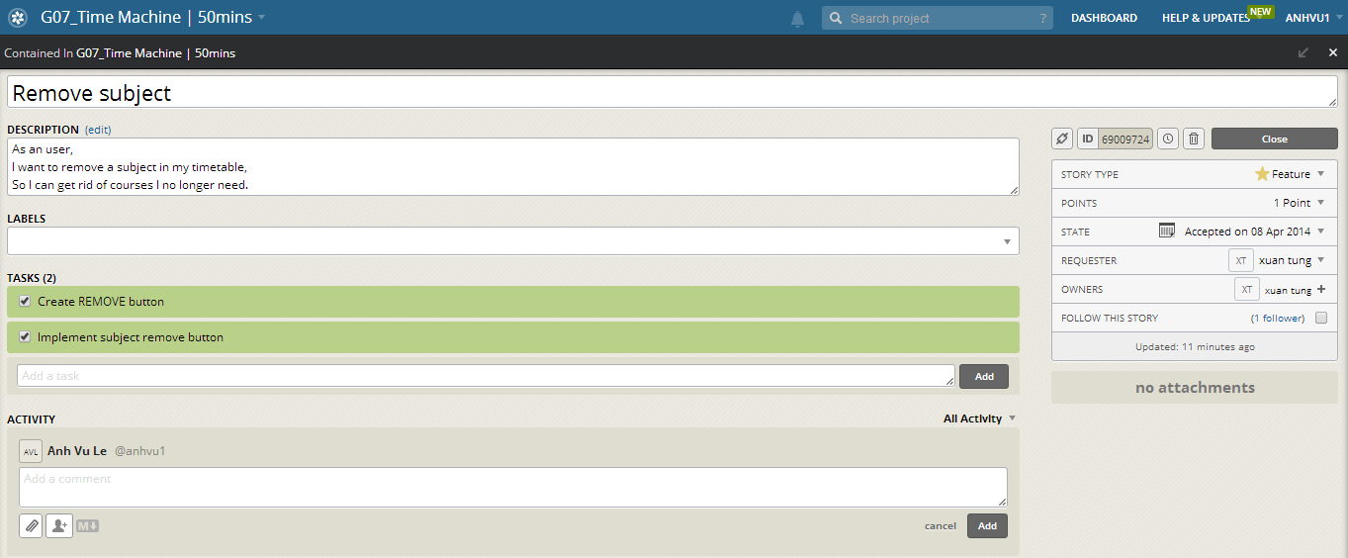
User Story #4

Slide 10
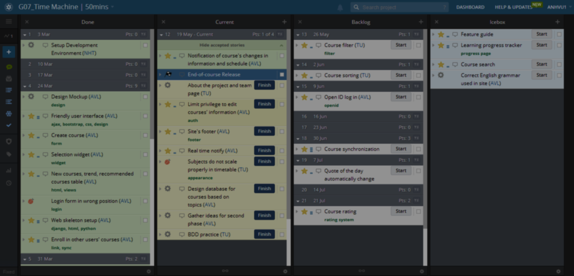
39 stories, 19 finished

Slide 11
Each story is short, contains 3 standard parts with focus on comprhensiveness

Slide 12
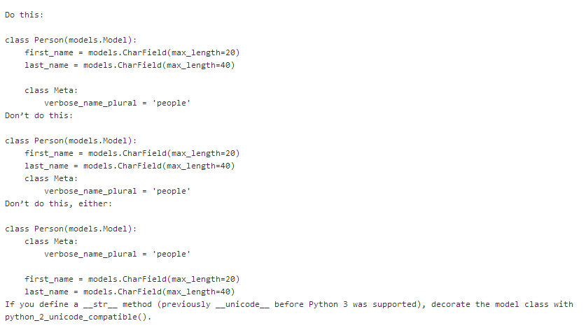
Following PEP = Python Enhancement Proposal
Coding Style

Slide 13

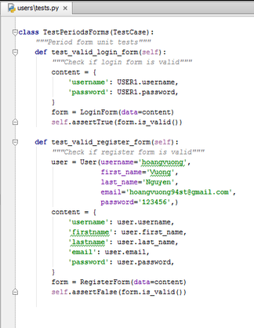
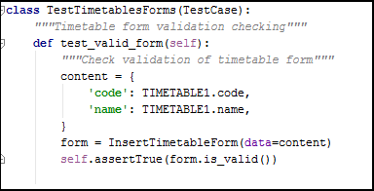
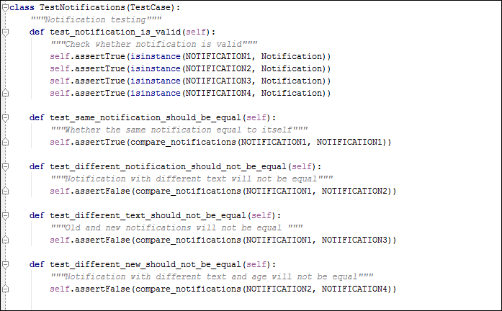
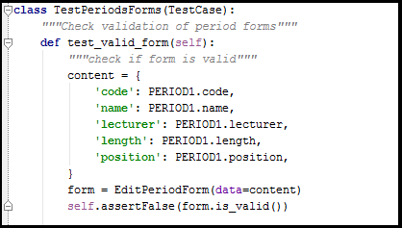
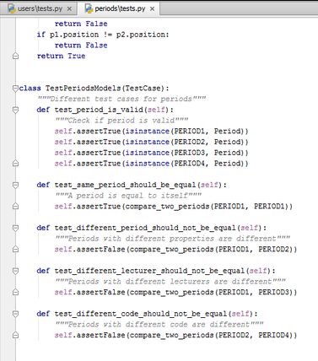
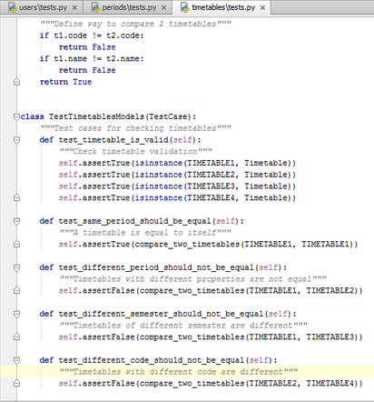
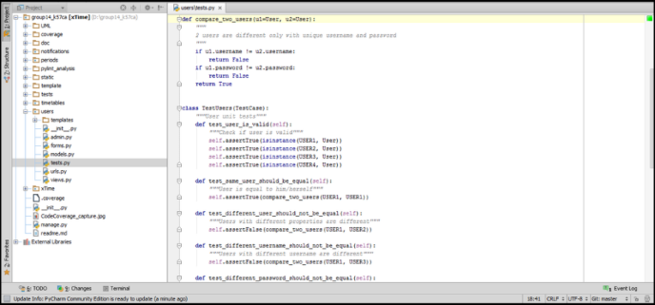
Test

Slide 14
Every module has tests!
Every test has comprehensive name & comment on what it does

Slide 15
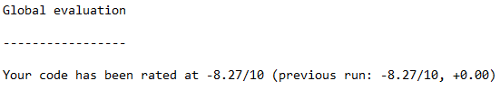
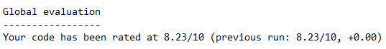
Reactor/Analysis
BEFORE
AFTER

Slide 16

Common Mistakes
Reactor/Analysis
Missing docstring
Invalid-name
Line-too-long
Bad-indentation (Really annoying!!)

Slide 17
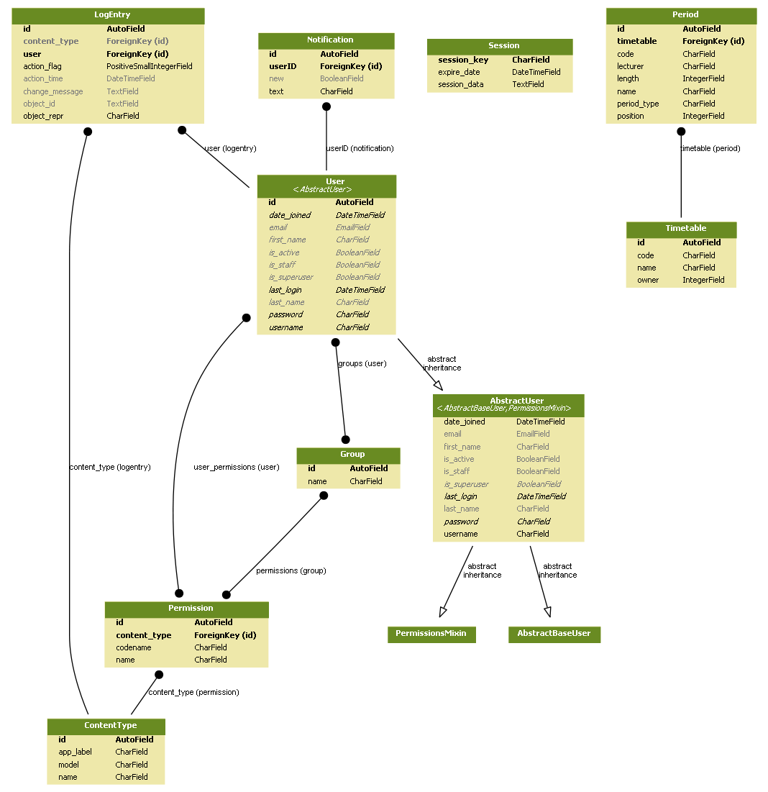
Model Diagram

Slide 18
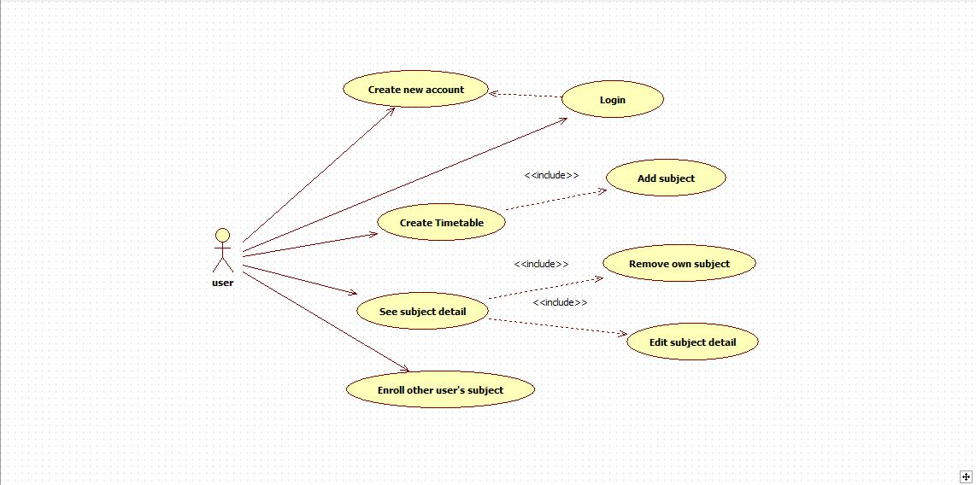
Use Case Diagram

Slide 19
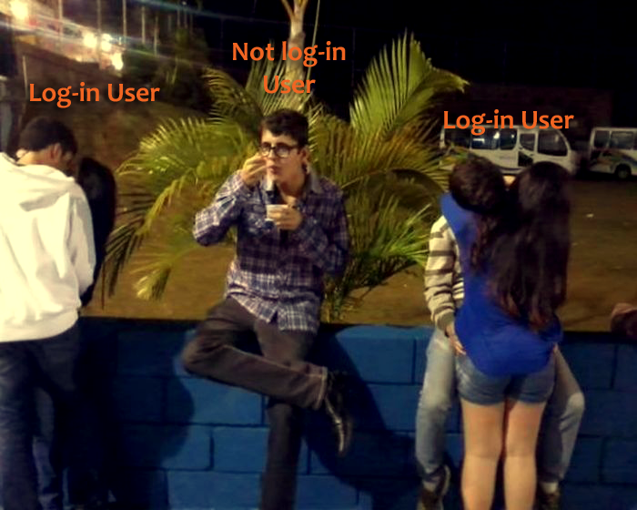
Use Case visual illustration

Slide 20
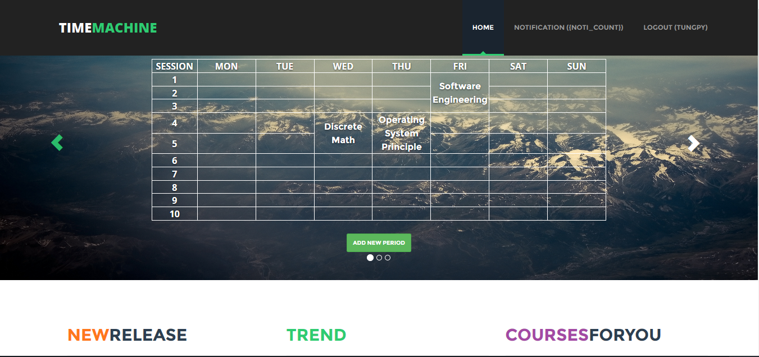
Final Product

Slide 21
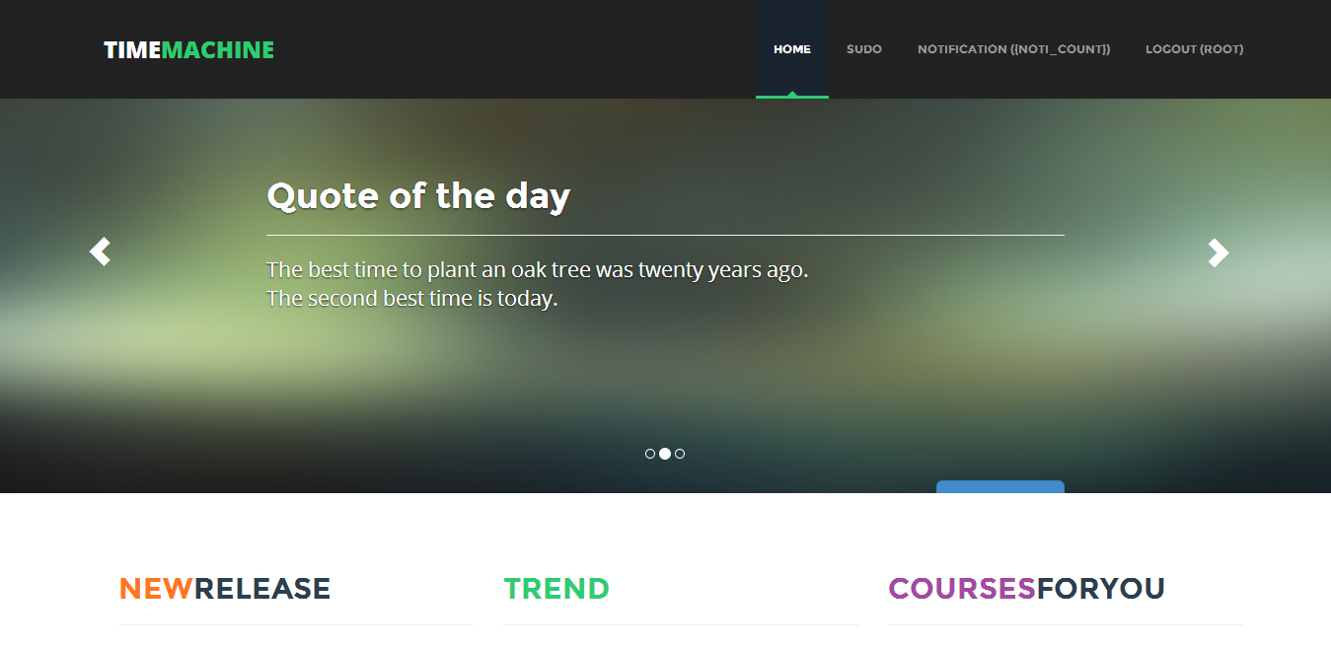
Final Product

Slide 22
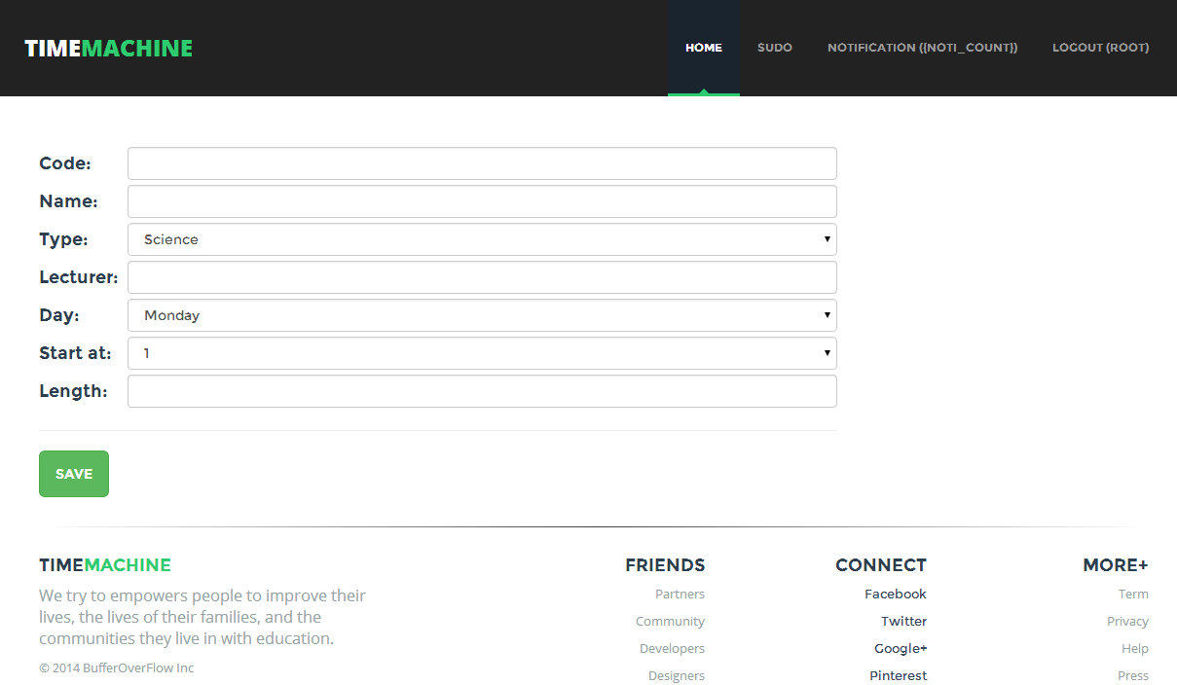
Final Product

Slide 23
Final Product
HOW TO USE ?

Slide 24

Final Product

Slide 25


